Slide 1
Zagreb, March 2014
Child friendly social services and Barnahus in Iceland
Bragi Gudbrandsson, Director General

Slide 2
The UN CRC,
25 years Anniversary
Not only quantitatively but also qualitatively different from earlier international agreement
The twofold nature of the UN CRC
  The Descriptive
  The Normative (dynamic)
Culturally sensitive and thus flexible within the limits of the basic principle of the “best interest of the child”

Slide 3
CoE Achievements:
Standard Setting for Enhancing the Rights of Children
Translating/Operationalizing the Rights into the different context in the life of children such as:
  Institutions, Rec (2005)5
  Family environment - Parenting; Rec (2006)19
  Judicial system; the Guidelines 2010
  Child friendly -Social services; Rec (2011)12
  Health Care; Guidelines 2011
  Participation in Society; Rec (2012)2

Slide 4
Diverse traditions, understanding and approaches
The Juxtaposition of Responsibilities for Policy and Delivery with regard to the state, regional, local authorities and civil society
  Conservative/Liberal model
  A central European subsidiarity model
  The Latin or Mediterranean model
  The Nordic social democratic model
  An emerging welfare systems model of the post-communist countries

Slide 5
Models of child protection
The “Child Rescue” Model: investigatory, policing and procedurally driven focus
The “Family Support” Model: supportive intervention and partnership with families

Slide 6
Convergence towards a unified approach
The impact of
Un CRC and a new perception of the child
New knowledge, sharing of experiences and dissemination of information
ECHR, CETS no. 5 and CETS no.35
European Court of Human Rights (the Court)

Slide 7
Outline of the Recommendation
Scope and purpose
Definitions
Fundamental principles
General elements of child friendly social services
Key strategies
Promoting further actions

Slide 8
I. Scope and purpose
The Rec addresses the rights of the child in social service planning and delivery
It applies to all children without discrimination, in whatever situation, capacity or reason they may come into contact with social service agencies or these agencies deliver social services that affect their life
The Rec aims to ensure that the child´s age, level of maturity and understanding, an assessment of the child´s needs are taken into account as well as respecting the unique circumstances of each case

Slide 9
II. Definitions
The terms “child” and “parent”
“Social services”, personal as well as universal
“Social services for children and families”
  General Social Services
  Special Social Services
  Intensive Social Services

Slide 10
III. Fundamental principles
Provisions in the best interests of the child
The child´s right to participation
The child´s rights to protection

Slide 11
Provisions in the best interest of the Child
The diversity and quality of social services should be arranged with the overt aim of the best interest of the child
This involves emphasis on provisions for positive parenting
Appropriate responses to needs and quality of interaction between social service providers and children and families based on the following:
  Respect for the dignity of the child and his/her family
  Protection from discrimination
  Social inclusion
  Overcoming stigmatization
  Avoidance of dependency

Slide 12
Participation
Children should be heard and taken seriously
Children should be seen as „beings“, not only „becoming´s“
Participation at different levels: Consultative, Collaborative, Child-lead participation
Criteria for individual participation:
  Be informed
  Be supported to express their views
  Be listened to
  Have views taken into account
  To be heard is a right of the child, not a duty on the child

Slide 13
Protection
Supportive and appropriate measures to protect children in families addressing difficulties with the aim of family preservation
This involves inter alia the following principles:
  Prevention and early intervention
  Child focused partnership with families
  Assessment of the individual child´s need both with regard to protective and risk factors
  Interdisciplinary and multiagency collaboration
  Prevention of re-victimization

Slide 14
IV. Levels of child friendly social services
General social services
  Comprehensive, preventive and responsive
Specialised social services
  Addresses negative impact of adverse childhood experiences
Intensive social services
  The principle of appropriateness

Slide 15
V. Key delivery strategies in child friendly social service
  Information and advice
  Accessibility of services
  Availability
  Appropriateness, suitability
  Interdisciplinary and multiagency collaboration

Slide 16
V. Key strategies (continued)
  Professional competency: training, supervision and accountability
  Safety of the child
  Confidentiality, privacy rights
  Mechanisms for complaints and review of decisions affecting the child
  Quality standards, monitoring, evaluation

Slide 17
VI. Promoting further child friendly actions
To review domestic legislation, policies and practices in line with the Rec
To speedily ratify, if not yet done so, the relevant CoE conventions
To promote domestic and international cooperation, including research and sharing of good practice
To foster a dialog with stakeholders as well as the public on outcomes and general satisfaction of the child friendliness of social services

Slide 18
Barnahus, Iceland
Bragi Gudbrandsson

Slide 20
Research findings: procedural defects
Violation of the principle of the best intersts of the child: multiple interviews in different location
Lack of coordination/cooperation between the different agencies involved; Child Protection, Police, Prosecution, Medical profession, Therapists etc.
Lack of an interdisciplinary approach
Absence of appropriate guidelines in work practices
Lack of personnel with appropriate training and specialisation, especially in conducting investigative interviews

Slide 21
a historical note
Increased international awareness following the Stockholm Congress on commercial sexual exploitation of children in 1996
The first research on the incidence of child sexual abuse in Iceland, conducted by the GACP in 1997
The rate of child sexual abuse higher than imagined
The research outcome created a public demand for improved strategies cases of child sexual abuse

Slide 22
-Crimes of unique nature
The vulnerability of the child victim
  The “silent” crime, secrecy of the abuse
  Child victims difficulties in disclosures
The absence of evidence other than the child´s disclosure
  Medical evidence in less than 10% of cases and only conclusive in less than 5% of all cases
  Other hard evidence or witnesses other than the child victim´s rarely exist

Slide 23
The Child´s Disclosure
The Child´s disclosure is the key for:
  Ensuring the safety of the child
  Providing assistance to the child victim with the aim of physical and psychological recovery
  Uncovering the crime in terms of criminal investigation, prosecution and sentencing
  Preventing the perpetrator from reoffending
Dealing with Child Sexual Abuse is therefore the responsibility of many agencies

Slide 24
Multiple interviews –
Harmful to the Child Victim
  All the different agencies: the Child Protection Service, the Medical Profession, the Police etc. need to have the child´s account
  Repetitive interviews by many professionals in different locations can have very harmful effect for the child victim
  Retraumatization – re-victimisation
    Refers to painful/stressful re-experiencing of trauma as a consequence of sexual violence

Slide 25
Violation of the “best interest of the child”
Investigation often generates painful experiences for the child victim

Slide 26
UN CRC
Article 3.1
“In all actions concerning children, whether undertaken by public or private social welfare institutions, courts of law, administrative authorities or legislative bodies, the best interest of the child shall be a primary consideration”

Slide 27
Child-friendly
The goal is to identify child-friendly strategies and practices to ensure:
The „best interests of the child“
without compromising the human right principle:
The “due process” (fair trial)

Slide 28
multiagency collaboration
The Gov. Agency for Child Protection
The State Police
The State Prosecution
The Police Dep. in Reykjavik
The University Hospital – Dep. of Peadiatrics and Dep. of child Psychiatry
Association of the Directors of Local Social Services
The Child Protection Services in Reykjavik

Slide 29
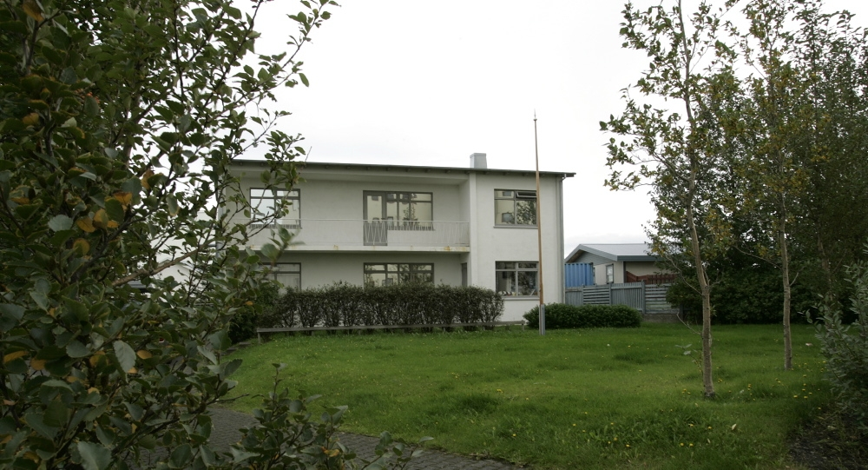
the Barnahus in Reykjavík

Slide 30
Barnahus
Joint Investigative Interviews
Victim
Therapy
Medical Exams and Evaluation
Family Counselling/ Support
Consultation and advice to local CPS
Education, training, research

Slide 31
Court testimonies
(Joint investigative interviews)
The Court Judge is in charge of the procedure
The Prosecution
The Police
The CPS representative
The Child’s Legal Advocate
The Defence
Testimonies in Reykjavík Court
Police interviews with victims 15-16 years

Slide 32
Controversies
Controversial changes in the legislation
The Court Judges´ discretion:
  where and how to take the child witness statement
  if a specialised interviewer is made use of or not
  if the child/parents should affect decisions above
The implementation of the principle of “Equality of arms”
- “evidential immediacy”
- “adversarial procedure”

Slide 33
CPS exploratory interview
Guidelines:
At the request of the Child Protection Services
Disclosure is absent or very weak/ambigious
Offender has not been identified
Offender is below the age of criminal responsibility (15 years)

Slide 34
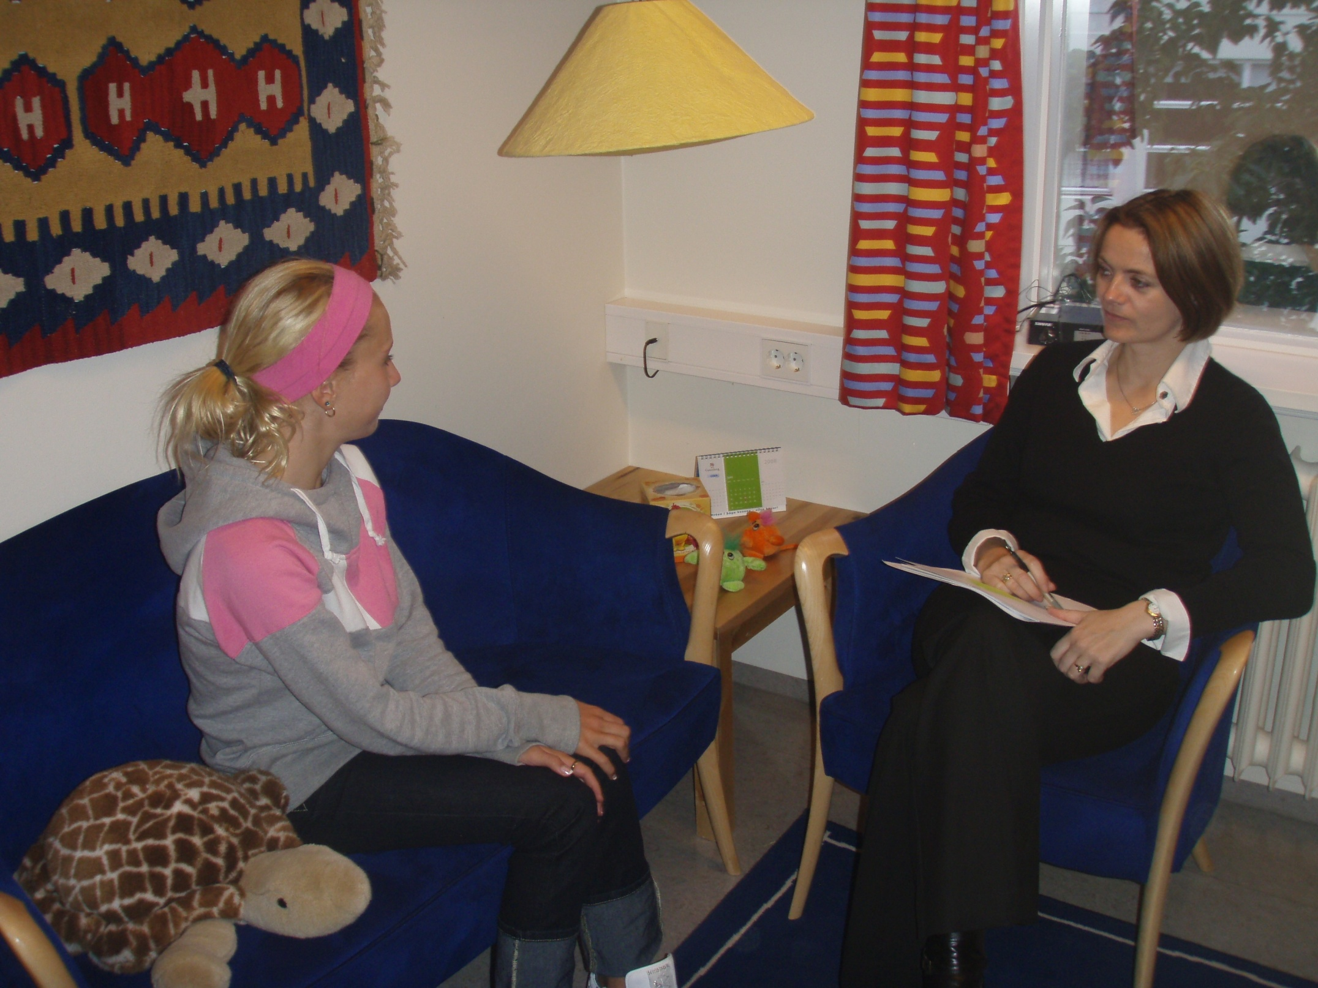
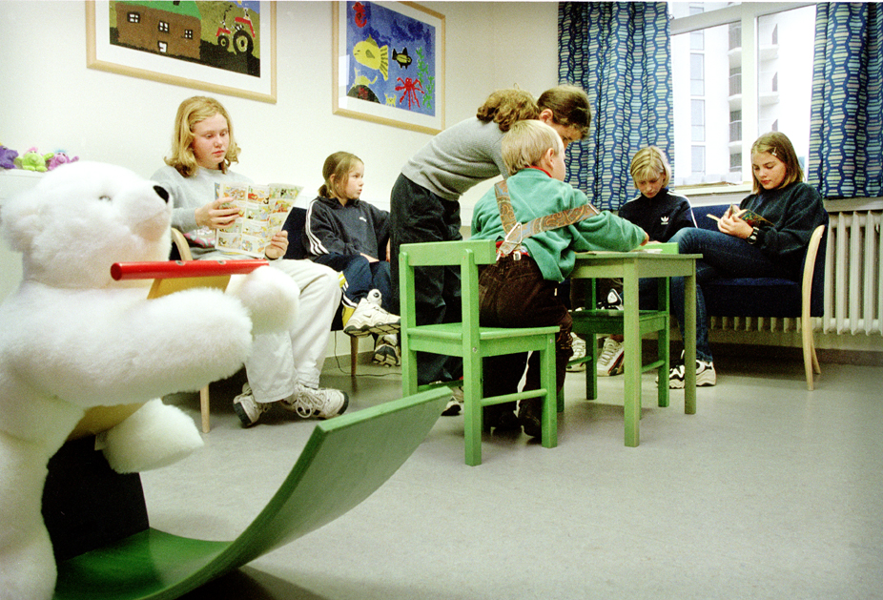

Slide 35
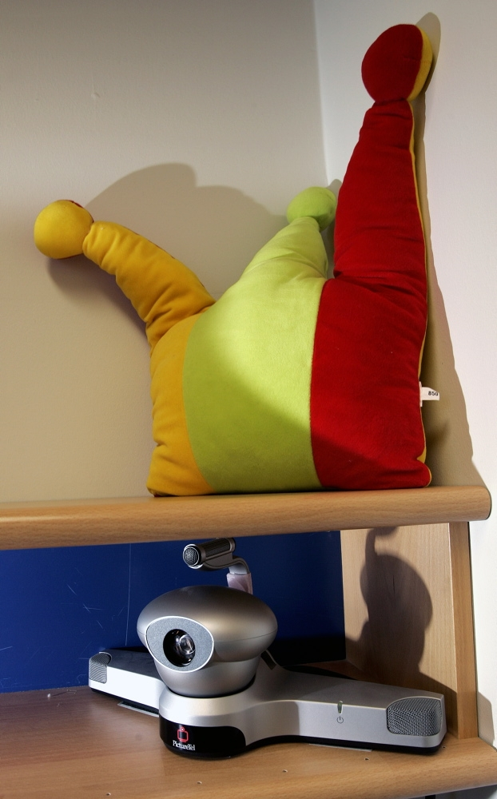

Slide 36
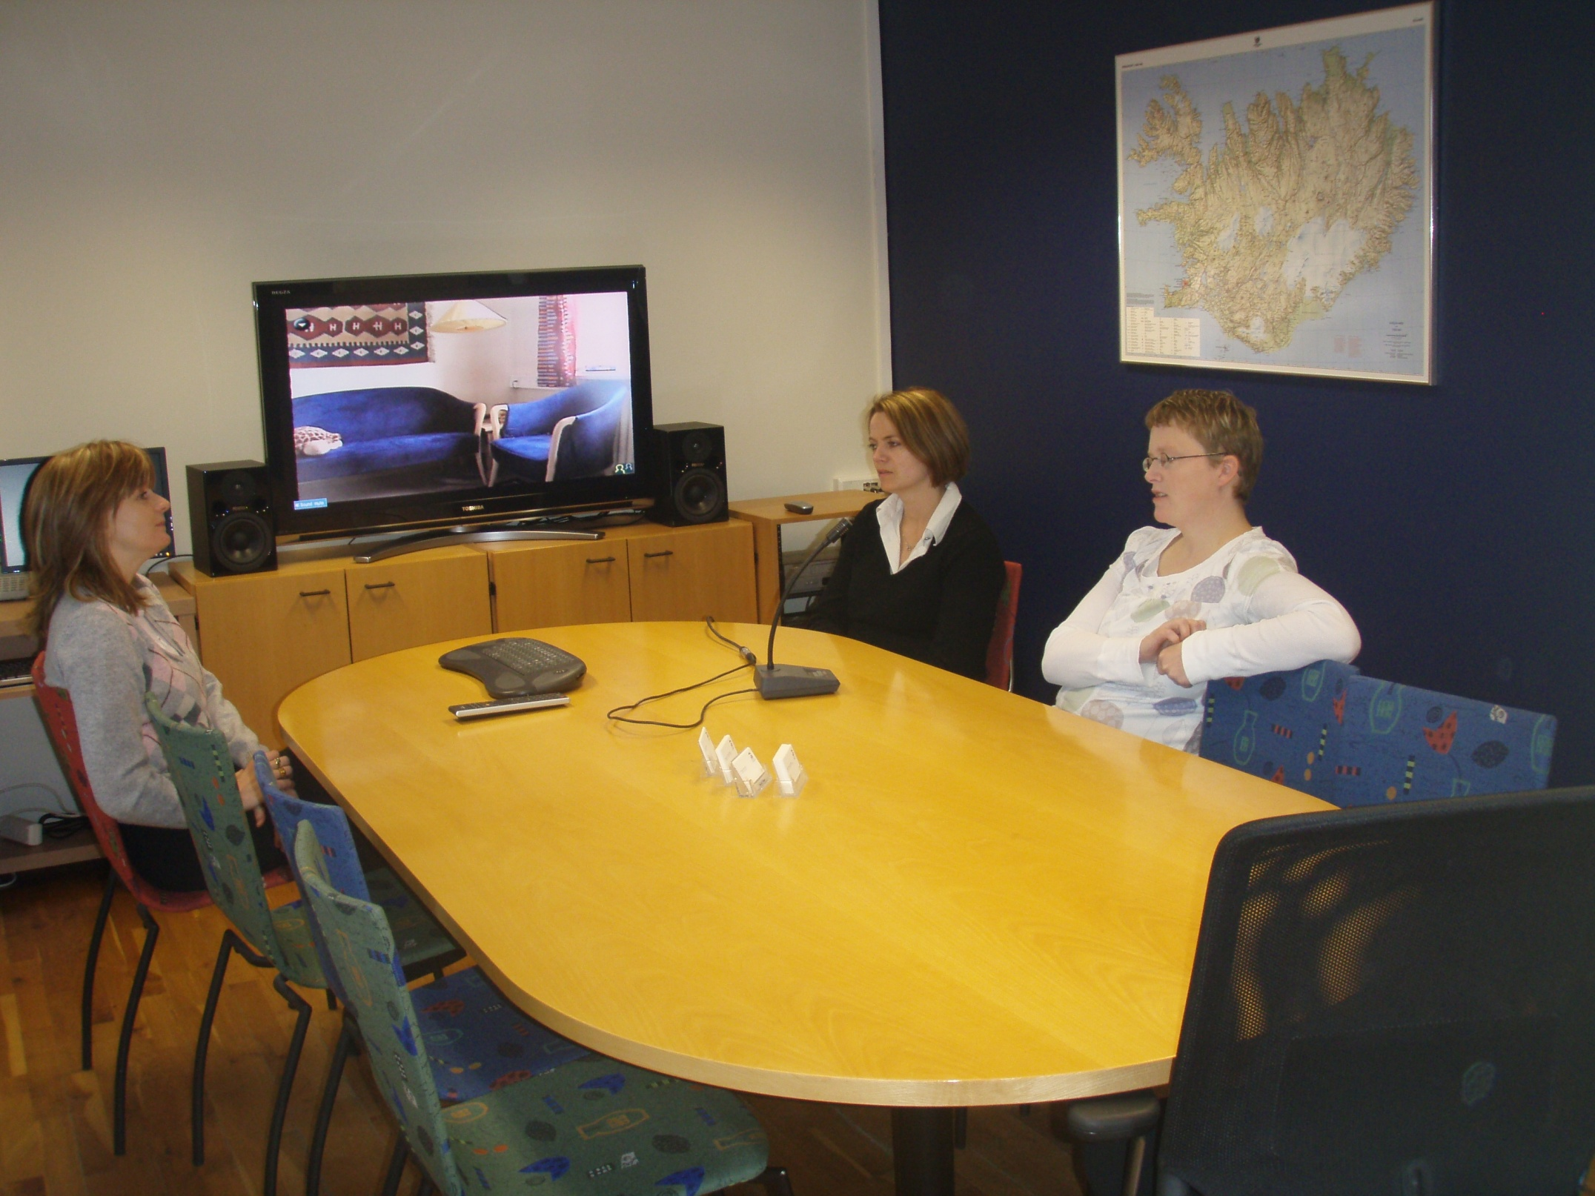
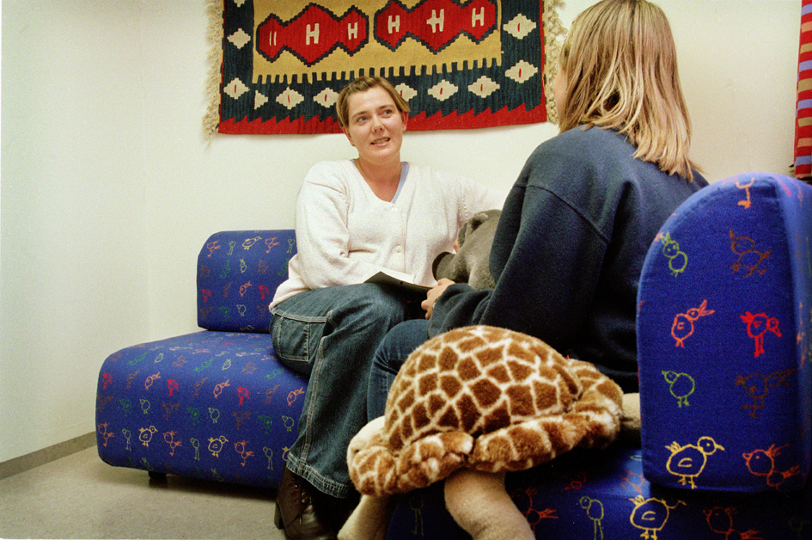

Slide 37
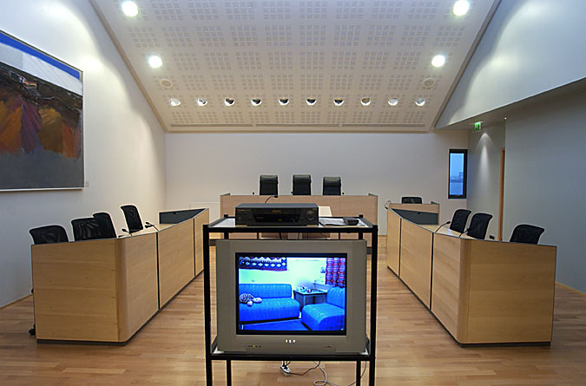

Slide 38
Investigative interviews
1998 -2013

Slide 39
medical examinations
At the request of the Police, the CPS, the Child or the Parents
Implemented by experienced paediatrician, a gynaecologist and a trained nurse
A child friendly examination room
The use of “video-colposcope” and it´s therapeutic value by active participation of the child
Anaesthesia exceptional
Acute forensic medicals performed at UH

Slide 40
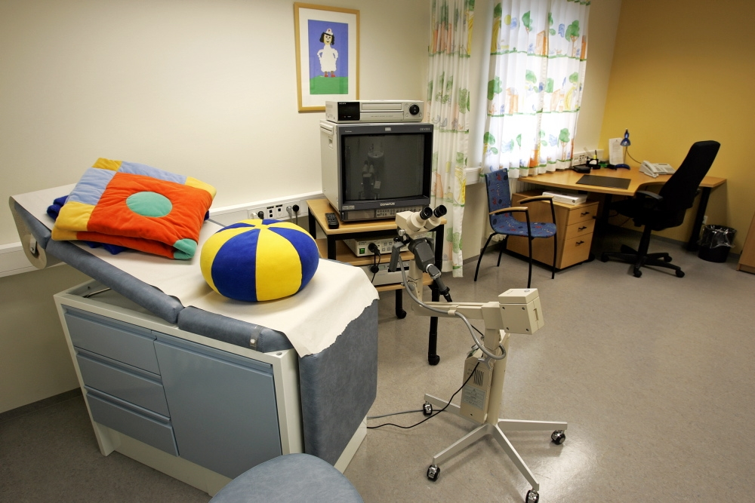

Slide 41
Medical examination: Children´s House v.s acute forensic exams at the University Hospital

Slide 42
victim therapy - family counselling
The child and the non-offending parent(s) receive (legal) counselling immediately after the investigative interview
Victim therapy can start soon after
The dual role of interviewer/therapist excluded in individual cases
The videotaped child´s disclosure is used for initial assessment and treatment plan
Cognitive-behavioural therapy – group therapy under way
The therapists are generally required to submit reports and testify in court proceedings

Slide 43
Number of treatment cases

Slide 44
2011-2013

Slide 45
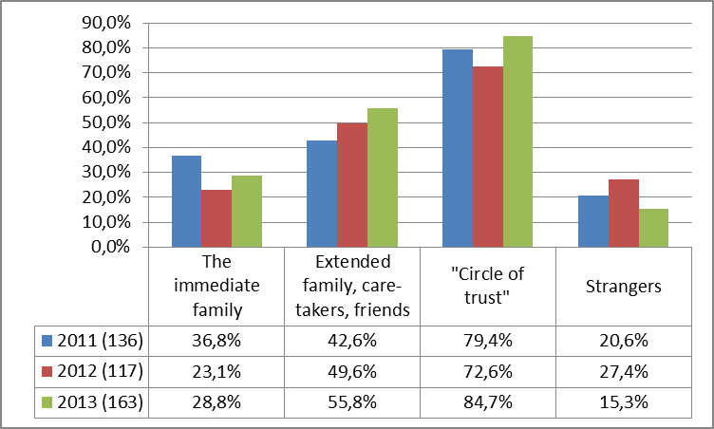
Victim/offender relations

Slide 46
fifteen years of experience
Nearly 4.000 children have been referred to Barnahus from the onset in 1998; appr. 250 - 300 annually in recent years
The number of:
  Cases investigated have more than doubled
  Indictments pr. year have more than tripled
  Convictions pr year have more than doubled
Evaluation shows significantly better outcomes for child victims and their families

Slide 47
Tracing the Cases
Research findings on child sexual abuse 1995-97 compared to official statistics from the State Prosecution 2006-2008

Slide 48
Further achievements
Significant improvement, not only in terms of quantity, also quality of procedure: efficient, professional and child friendly response
Appropriate therapeutic services for child victims
Re-victimization of the child victim minimized
Mutual professional trust among the different agencies
Assimilation of knowledge and experience; fountain of data for research
Increased public awareness and confidence in the authorities

Slide 49
Additional benefits: Research on the ability of victims of childhood sexual abuse (CSA) to give credible evidence.
Objective: to investigate age related differences in factors associated with the nature of the allegations and the competence to give evidence and witness abilities.
Findings:
  The great majority of the youngest children, and almost all of the older children, have the basic competence to give testimony, although there are important age-related differences in basic abilities related to witness competence.
  Important age related differences were found in relation to the nature of the allegations.
  The youngest children had greatest problems with sustaining concentration during the interview and to provide detailed disclosure on the suspected abuse.

Slide 50
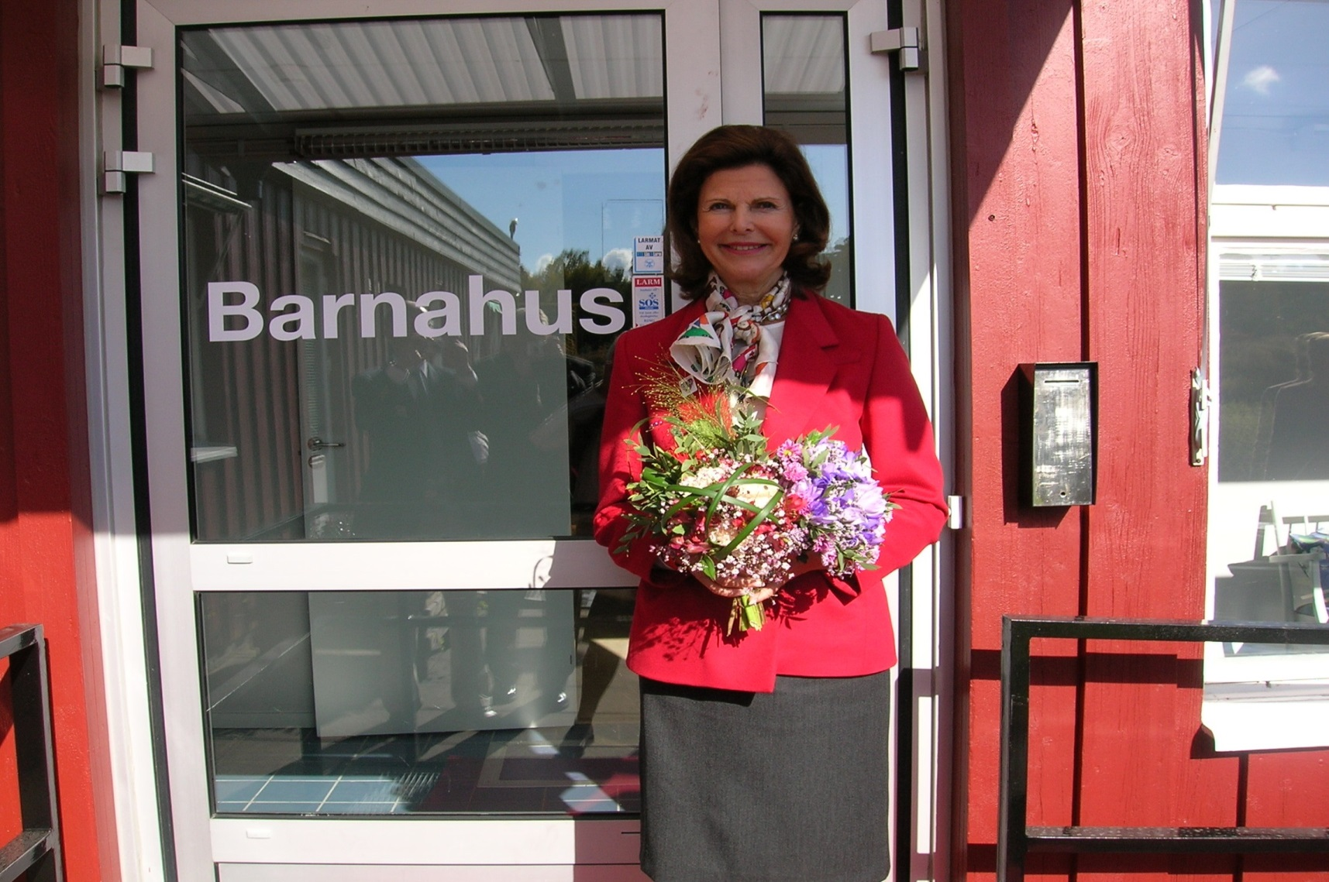
Opening of Barnahus in Sweden, 2005

Slide 51
Norway
2000 – 2005 Save the Children promotes the model
2005 Norwegian parliament decides on a pilot
2006 Report on implementation
2007 the first Children´s House in Norway (Bergen)
10 facilities in operation

Slide 52
Denmark and some further developments
New Act. on Social Sevice mandate response to reports of abuse an neglect within 24 and a referrals to Barnahus.
Five Barnahus opened in November 2013
The first Children´s House in Greenland opened in 2011 and in the Faroe islands in 2014
The Ministry of Justice in Finland decided on a „pilot“ Children´s House in 2011
The Ministry of Social Security and Labour in Lithuania started preparation for setting up Children´s House in 2012
Netherlands, Latvia, Greece, Turkey

Slide 53
The Lanzarote Convention
Unique among International Agreements
Basic characteristics:
  Child-friendly
  Comprehensive
    In terms of scope
    In terms of content
  Interdisciplinary/Multiagency
  Proactive

Slide 54
UN and CoE Standard setting
  Guidelines on Child friendly justice
    Promoting other child-friendly actions:
    “set up child-friendly, multi-agency and interdisciplinary centers for child victims and witnesses where children could be interviewed and medically examined for forensic purposes, comprehensively assessed and receive all relevant therapeutic services from appropriate professionals”
  Rec(2011)12 on Children´s Rights and Social Services
  The UN Guidelines on Justice in Matters involving Child Victims and Witnesses of Crime (2005)

Slide 55
Investigative interviews: age

Slide 56
Investigative interviews: sex

Slide 57
Children who disclose SA

Slide 58
Treatment cases: age

Slide 59
Medical examination: Children´s House v.s. acute forensic exams at the University Hospital

Slide 60
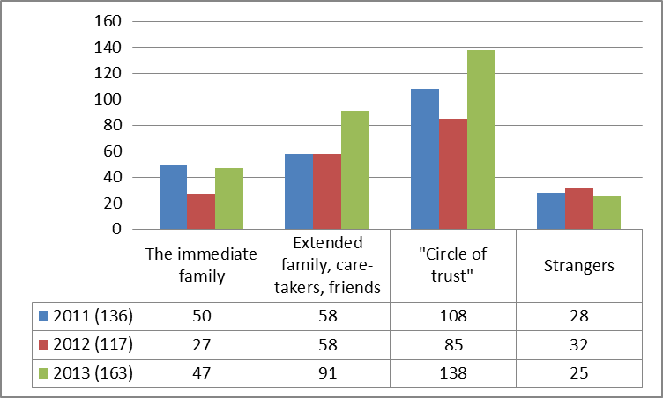
Victim/offender relations

Slide 61
reports to local CPS on suspected SA

